Slide 1
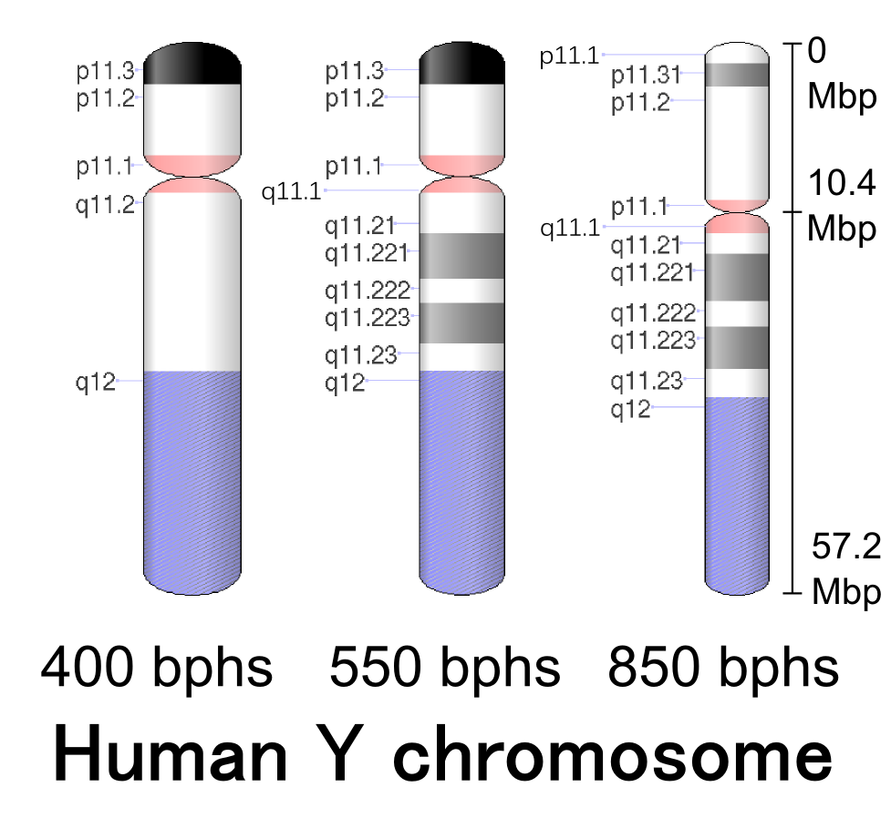
APL (A Programming Language)
55 years of enjoyment and uses
Autosomal pedigree
Y pedigree
Y chromosome
Charles Brenner, Ph.D.
Purveyor of forensic mathematics,
DNA∙VIEW®
charles@dna-view.com
http://dna-view.com

Slide 2
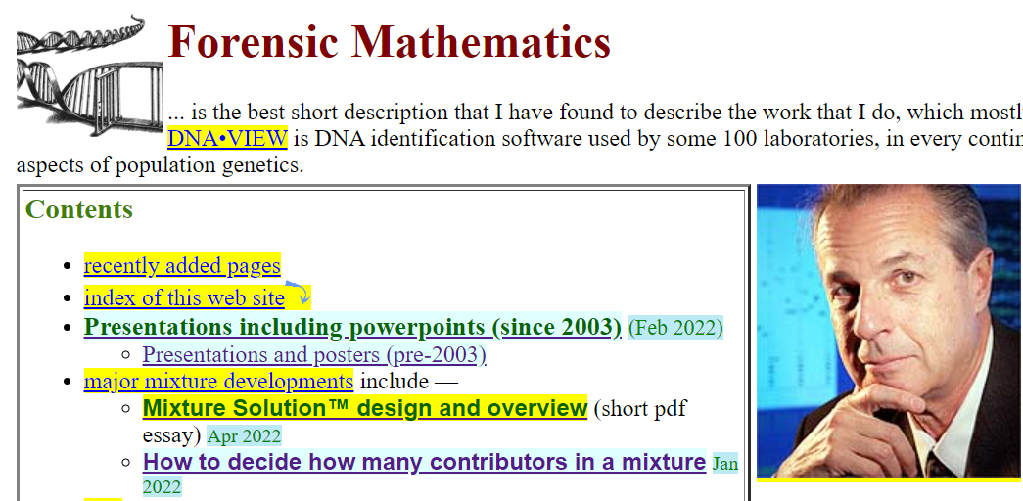

Slide 3
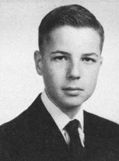
The Beginning
No, not Charles Babbage & Lady Lovelace (1822)
Not even Alan Turing (1936)
ENIAC? False start (1955)
Computer built of HS students (1959)
  Prof Forsythe (founder of Computer
  Science dept at Stanford)
  Masterful diagnosis
Stanford’s computer: IBM 650
  Language: raw decimal
high schooler

Slide 4
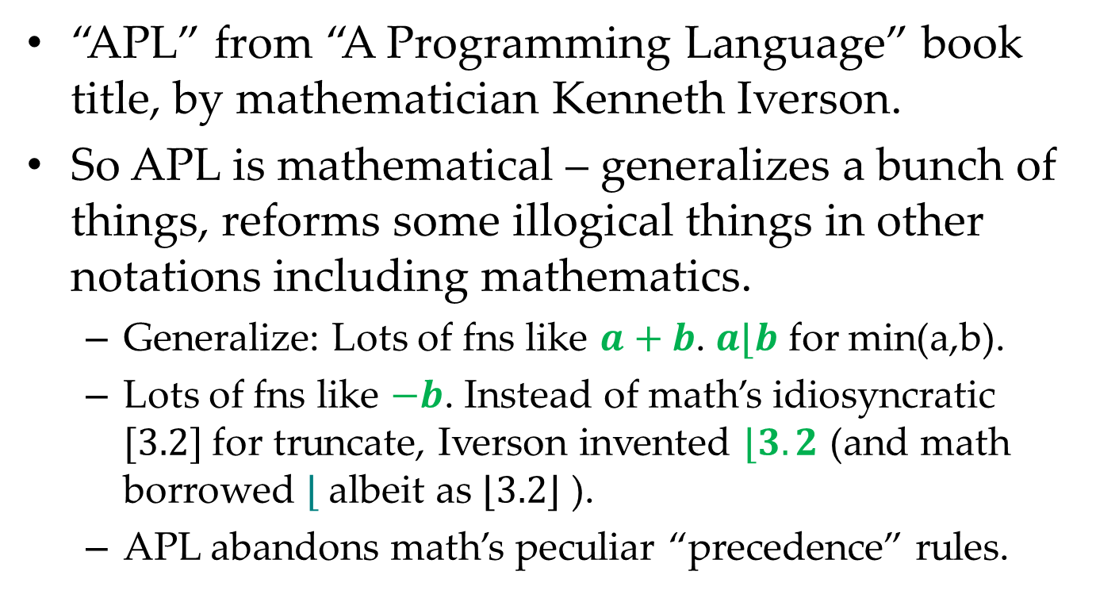
What is APL?
“APL” from “A Programming Language” book title, by mathematician Kenneth Iverson.
So APL is mathematical – generalizes a bunch of things, reforms some illogical things in other notations including mathematics.
  Generalize: Lots of fns like $a+b$. $a⌊b$ for min(a,b).
  Lots of fns like $−b$. Instead of math’s idiosyncratic $[3.2]$ for truncate, Iverson invented $⌊3.2$ (and math borrowed $⌊$ albeit as $⌊3.2⌋$ ).
  APL abandons math’s peculiar “precedence” rules.
Notes:
Not a joke. Originally for expressing algorithms to humans – vide 2-dimensional notation.
Early computer pioneers came from disparate areas. Eugene McDonnell

Slide 5

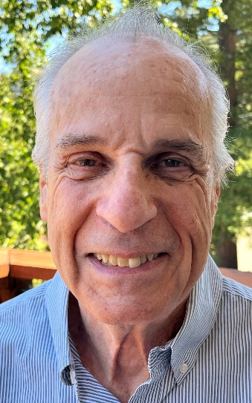
Context
At first Iverson’s idea was a notation to describe algorithms. Computer implementation was later.
Today several APL vendors, dialect variations.
I did some APL development 30 & more years ago. Now I’m a “domain expert” in forensic DNA identification.
I now use Dyalog APL, on PC
  Free for student use
  Tutorial web pages
  Runs on PC, Mac, Raspberry Pi(!),
  nearly Android

Slide 6
Concise
A line of APL is likely 10 lines of C.
Short programs are
  Easier to write
  Easier to read
  Easier to revise and enhance
  Easier to debug
  and therefore are faster! (“For programs over 2000 lines, a high level language is faster” said my 1966 group leader at Lockheed.) My APL is fast.
One person can do the work of 10.

Slide 7
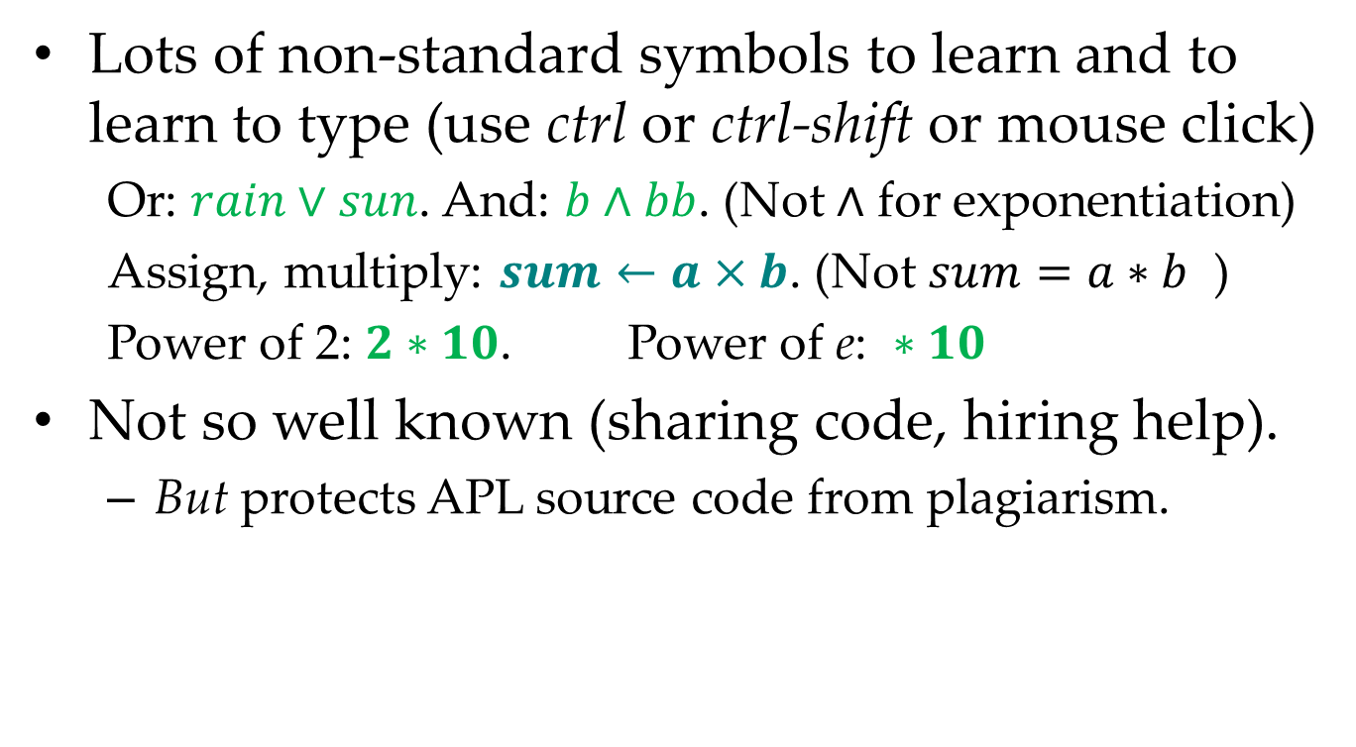
Fair warning – (negatives)
Lots of non-standard symbols to learn and to learn to type (use ctrl or ctrl-shift or mouse click)
  Or: $rain∨sun$. And: $b∧bb$. (Not $∧$ for exponentiation)
  Assign, multiply: $sum←a×b$. (Not $sum=a∗b$ )
  Power of 2: $2∗10$. Power of e: $∗10$
Not so well known (sharing code, hiring help).
  But protects APL source code from plagiarism.

Slide 8
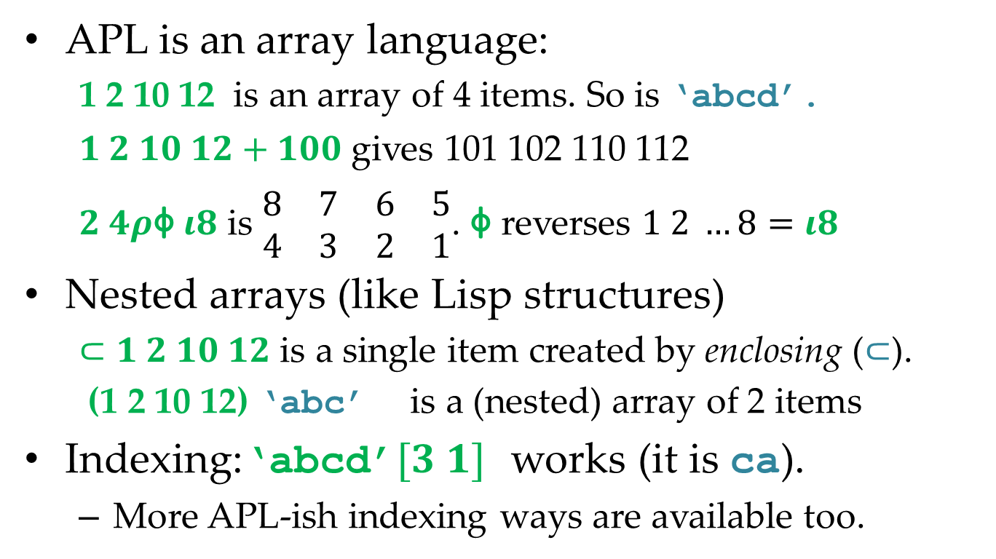
Useful & fun data structures
APL is an array language:
  1 2 10 12 is an array of 4 items. So is ‘abcd’.
  $1 2 10 12+100$ gives 101 102 110 112
  $2 4ρ$⌽ $ι8$ is $\begin{matrix}8 & 7 & 6 & 5 \\ 4 & 3 & 2 & 1\end{matrix}$. ⌽ reverses $1 2 …8=ι8$
Nested arrays (like Lisp structures)
  $⊂1 2 10 12$ is a single item created by enclosing ($⊂$).
  (1 2 10 12) ‘abc’ is a (nested) array of 2 items
Indexing:‘abcd’$[3 1]$ works (it is ca).
  More APL-ish indexing ways are available too.

Slide 9
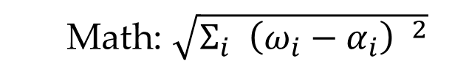


Dfns – “defined” function?
APL can be functional programming.
  Functional programming: no side effects
Dfns – simplified syntax functions
  Typically small task – 1-2 statements
  Dist←{(+/(⍵ - ⍺)*2)* ÷2}
  Euclidean distance between ⍺ and ⍵
  Math: $\sqrt{Σ_{i} {\left(ω_{i}−α_{i}\right) }^{2}}$
(5,3)
3
⍵
d←2 1 Dist 5 3
d
3.60555
2
$$ω_{2}−α_{2}$$
(2,1)
1
⍺
$$ω_{1}−α_{1}$$
0
0 1 2 3 4 5

Slide 10
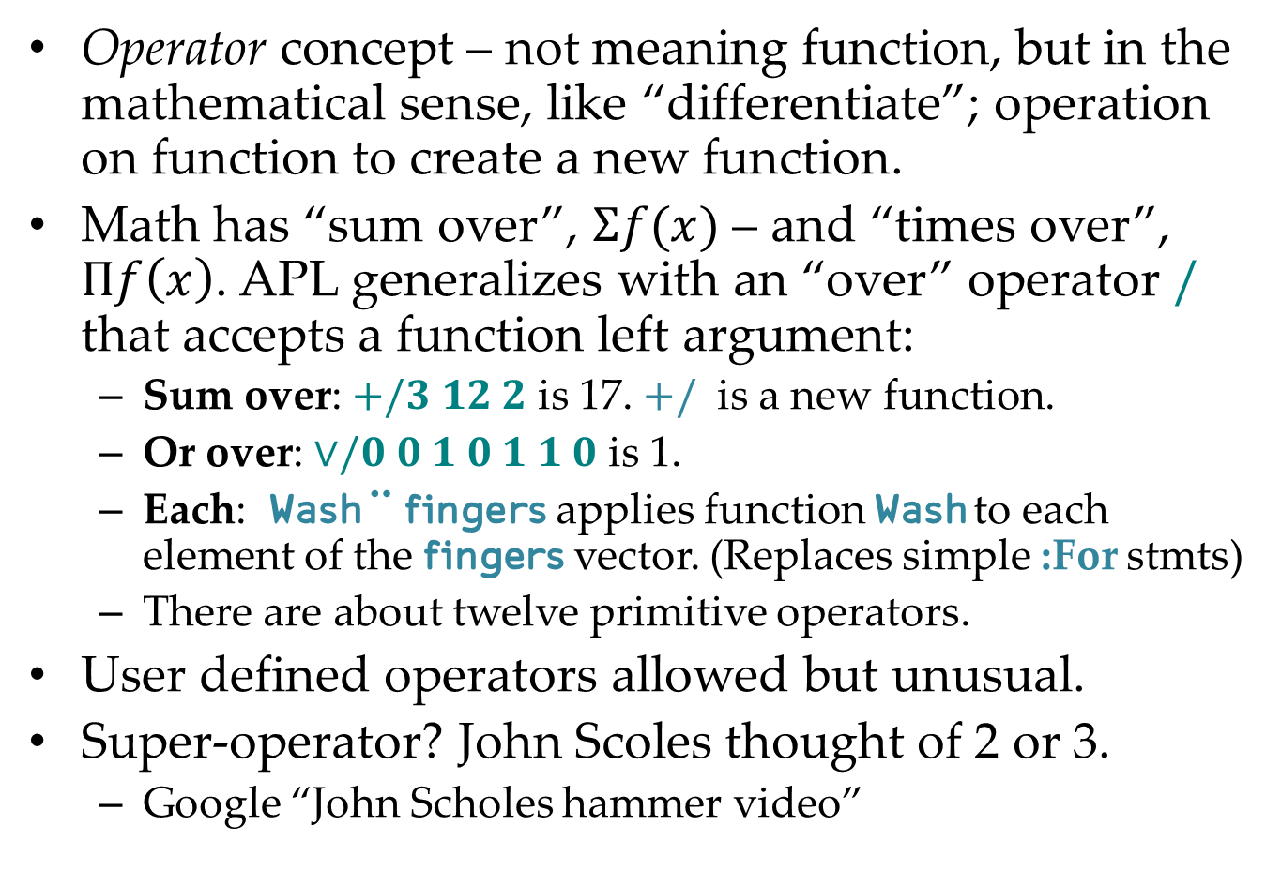
Great stuff – operators
Operator concept – not meaning function, but in the mathematical sense, like “differentiate”; operation on function to create a new function.
Math has “sum over”, $Σf(x)$ – and “times over”, $Πf\left(x\right)$. APL generalizes with an “over” operator $/$ that accepts a function left argument:
  Sum over: $+/3 12 2$ is 17. $+/$ is a new function.
  Or over: $∨/0 0 1 0 1 1 0$ is 1.
  Each: Wash ¨ fingers applies function Wash to each element of the fingers vector. (Replaces simple :For stmts)
  There are about twelve primitive operators.
User defined operators allowed but unusual.
Super-operator? John Scoles thought of 2 or 3.
  Google “John Scholes hammer video”

Slide 11
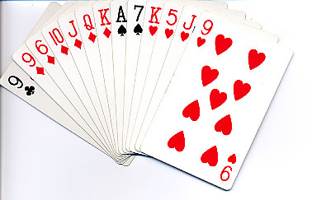
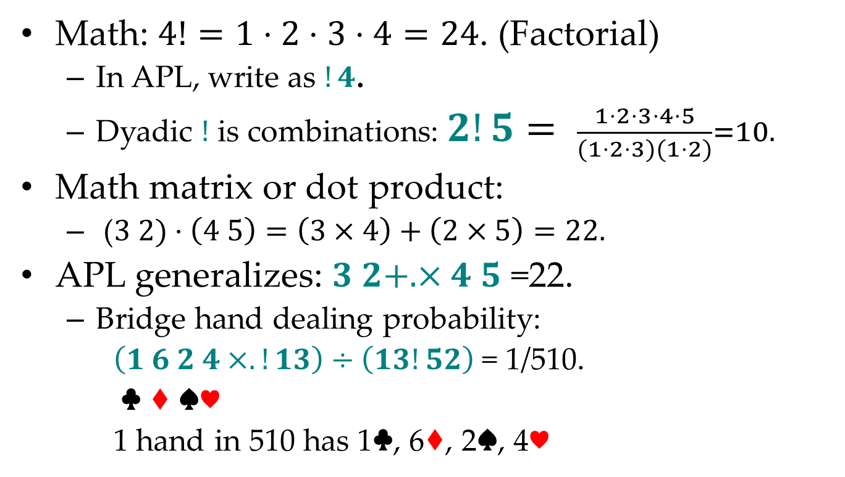
dot operator & card probabilities
Math: $4!=1⋅2⋅3⋅4=24$. (Factorial)
  In APL, write as $!4$.
  Dyadic $!$ is combinations: $2!5= \frac{1⋅2⋅3⋅4⋅5}{(1⋅2⋅3)(1⋅2)}=10.$
Math matrix or dot product:
  ($3 2)⋅\left(4 5\right)=\left(3×4\right)+\left(2×5\right)=22.$
APL generalizes: $3 2+. ×4 5$ =22.
  Bridge hand dealing probability:
  $\left(1 6 2 4×.!13\right)÷\left(13!52\right)$ = 1/510.
  ♣ ♦ ♠♥
  1 hand in 510 has 1♣, 6♦, 2♠, 4♥

Slide 12
Some applications
Modeling
  Model APL transpose function before implementing it.
  Venice Beach canals – mystery of the spot with trash
  Population genetics
    When do men share the same Y chromosome identifying locations?
    Evolution of STR size distribution
Error checking PhD thesis
Simulations
  Evaluate proposed lottery payoffs
  How many relatives needed to DNA identify a body?
Notes:
STR = 3% of genome. 1 million STRs

Slide 13
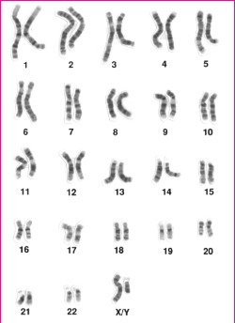
Karyogram of a human male
What’s Y?
Y halotype simulation project
Y chromosome

Slide 14
Typical identification locus within a chromosome (Y chromosome today)
chromosome
Electron microphotograph
showing 2 repeats of the motif.
Number of repeats varies between men thanks to occasional replication slippage mutations over the eons.
(1/5 = approximate chance of match at a locus)
Y haplotype = the information from about 15 standard loci of a man’s Y.
Sadly – the identifying power of the combined loci cannot be computed.
So various statistical ideas have been floated.

Slide 15
Evolution of the Yfiler lineages
mutation
Y-chromosome Adam”
…
Convergent mutation (rare)
110,000 ybp
today
(Same color = same Y-haplotype)
Notes:
Begin by reviewing the story of Y evolution. It starts about 110K years ago with Adam, the most recent common patrilineal ancestor of all living men. He passed his Y on to at least 2 sons (CLICK - or he wouldn’t be most recent), and they had sons (CLICK) etc. An STR haplotype like Yfiler is usually transmitted unchanged, but about 5% of sons inherit a mutation – different color – and so Yfiler diversity evolves.
A large majority of mutations are to a brand new type. That is the opposite of what many people expect intuitively.

Slide 16
All men are related
Great-great-… grandpa’s Y haplotype
MRCA (Most recent common ancestor)
5 6 4 4 …
6 6 4 5 …
5 6 4 4 …
5 6 4 4 …
6 6 4 5 …
6 6 4 4 …
Generations
5 6 4 4…
5 6 4 5 …
6 6 4 4 …
5 6 4 4 …
5 6 4 4 …
5 6 4 5 …
5 6 4 4 …
IBD (Identical by Descent)
(usual matching)
5 6 4 4 …
5 6 4 4 …
distant cousins
IBS (Identical by State) (unusual)
† Each box represents a 4-locus Y haplotype

Slide 17
Identity by State – closer look
5 6 4 4 …
5 6 4 5 …
MRCA (Most recent common ancestor)
5 6 4 5 …
2 pairs of cancelling mutations.
6 6 4 5 …
6 6 4 5 …
6 6 4 5 …
6 6 4 5 …
6 6 4 4 …
Unwind time …
6 6 4 4 …
IBS
5 6 4 5 …
6 6 4 4 …
6 6 4 4 …
5 6 4 5 …
5 6 4 4 …
5 6 4 4 …
5 6 4 4 …
5 6 4 4 …
5 6 4 4 …
IBS (Identical by State)

Slide 18
Y haplotype match condition
Suspect
5 6 4 4 …
Y haplotypes match (IBS)
if and only if the connecting patrilineage has n pairs of
cancelling mutations
for some n ∊ 0, 1, 2, ... .
NB: Ok to apply rule per-locus.
5 6 4 5 …
5 6 4 5 …
6 6 4 5 …
6 6 4 5 …
Connecting patrilineage
IBS
6 6 4 4 …
6 6 4 4 …
5 6 4 4 …
Donor
5 6 4 4 …

Slide 19
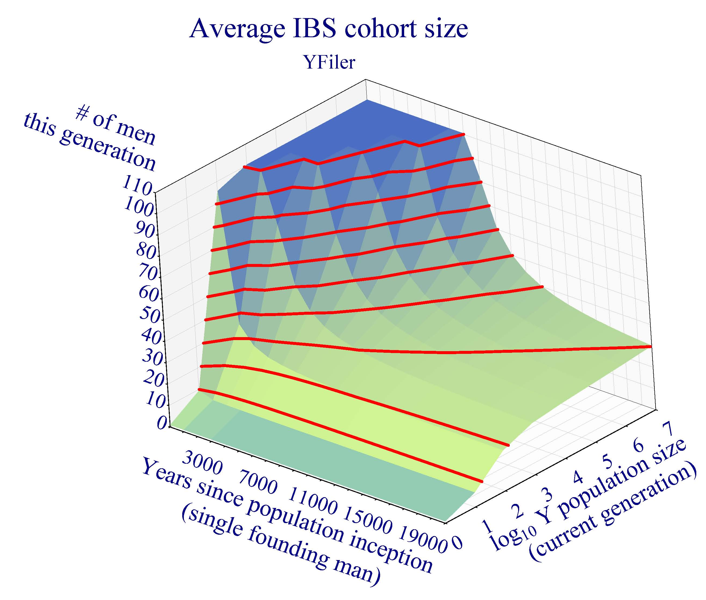
Number of men* with same haplotype
Average number of living men with the same Y haplotype
Assume constant population growth over Y years from 1 founding man to N men today.
Then typical haplotype is shared by H<100 men in the present generation.
H
Plateau!
Discovered by Monte Carlo simulations.*
Clearer picture by APL computation.**
N
Y
References
* Andersen & Balding
** Brenner

Slide 20

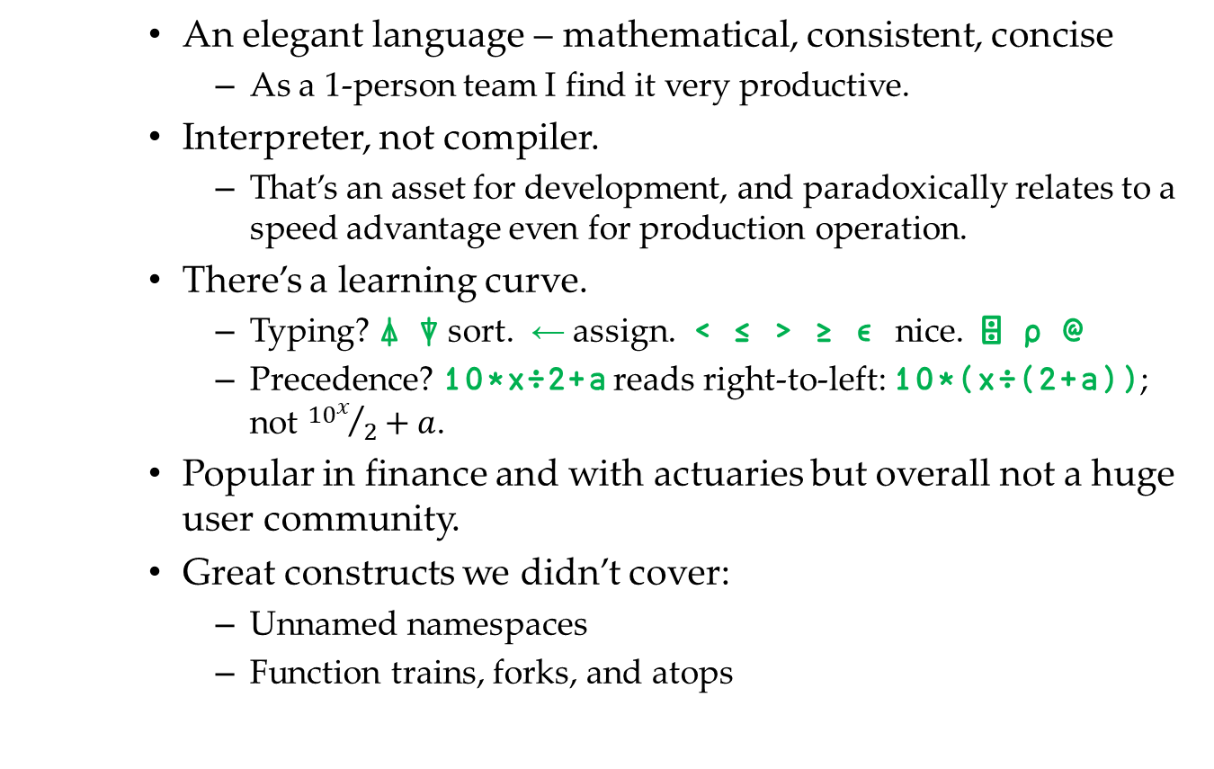
Epilogue
    An elegant language – mathematical, consistent, concise
      As a 1-person team I find it very productive.
    Interpreter, not compiler.
      That’s an asset for development, and paradoxically relates to a speed advantage even for production operation.
    There’s a learning curve.
      Typing? ⍋ ⍒ sort. ← assign. < ≤ > ≥ ∊ nice. ⌹ ⍴ @
      Precedence? 10*x÷2+a reads right-to-left: 10*(x÷(2+a)); not ${{10}^{x}}/2+a$.
    Popular in finance and with actuaries but overall not a huge user community.
    Great constructs we didn’t cover:
      Unnamed namespaces
      Function trains, forks, and atops

Slide 21
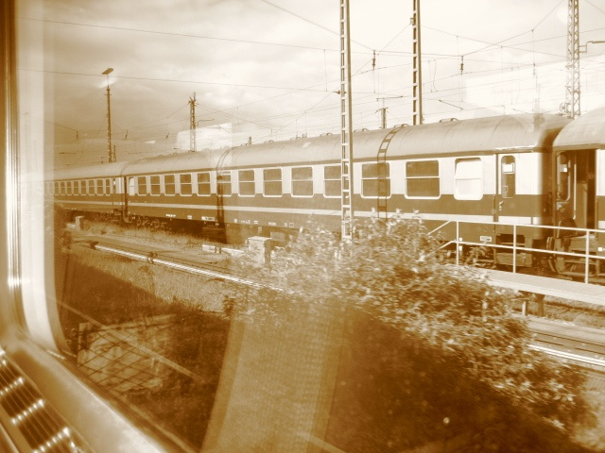
charles@dna-view.com
http://dna-view.com
☎+1 510 798 7139
The end
This work received no support from the NIJ, IMF, World Bank, Bill and Melinda Gates, or the Ford Foundation. Even Queen Isabella of Spain (usually a soft touch) wouldn’t pitch in.

